Slide 1
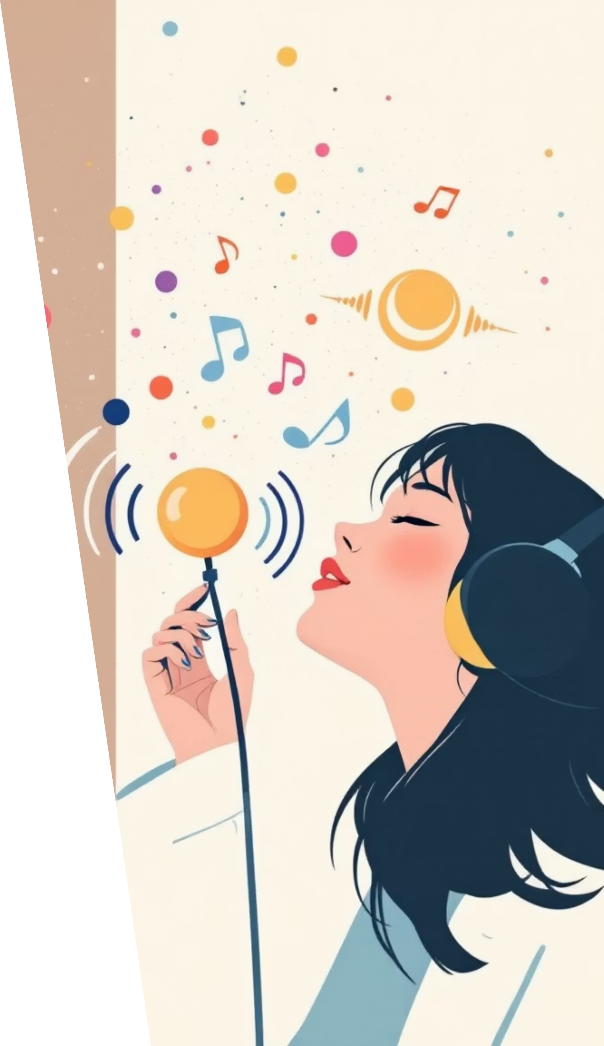
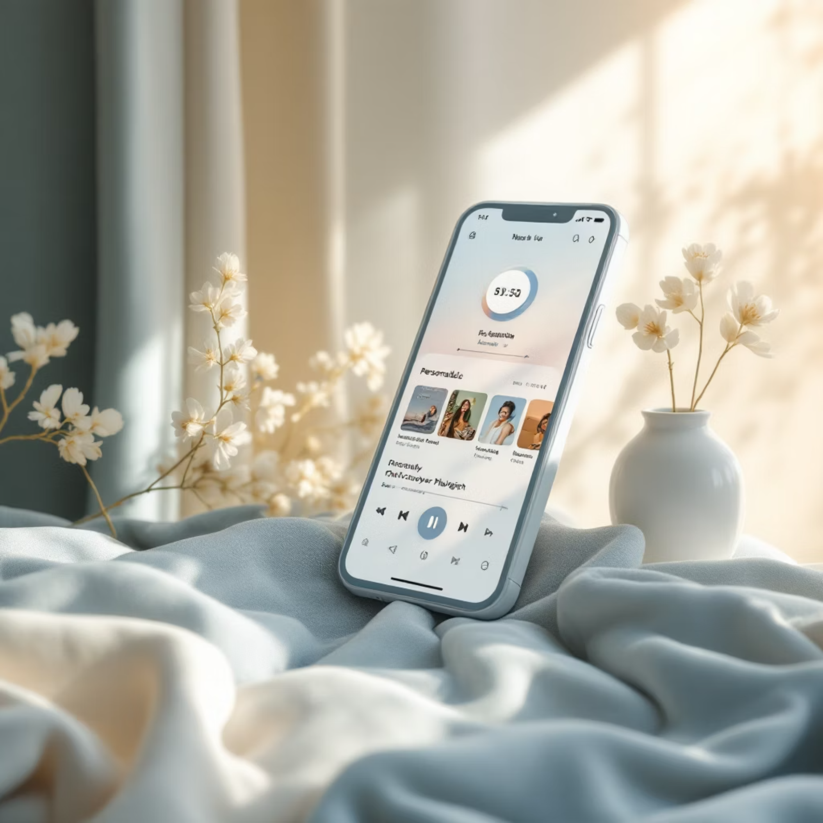
🎧 Music Streaming App
Personalized Music Discovery & Playlist Curation

Slide 2
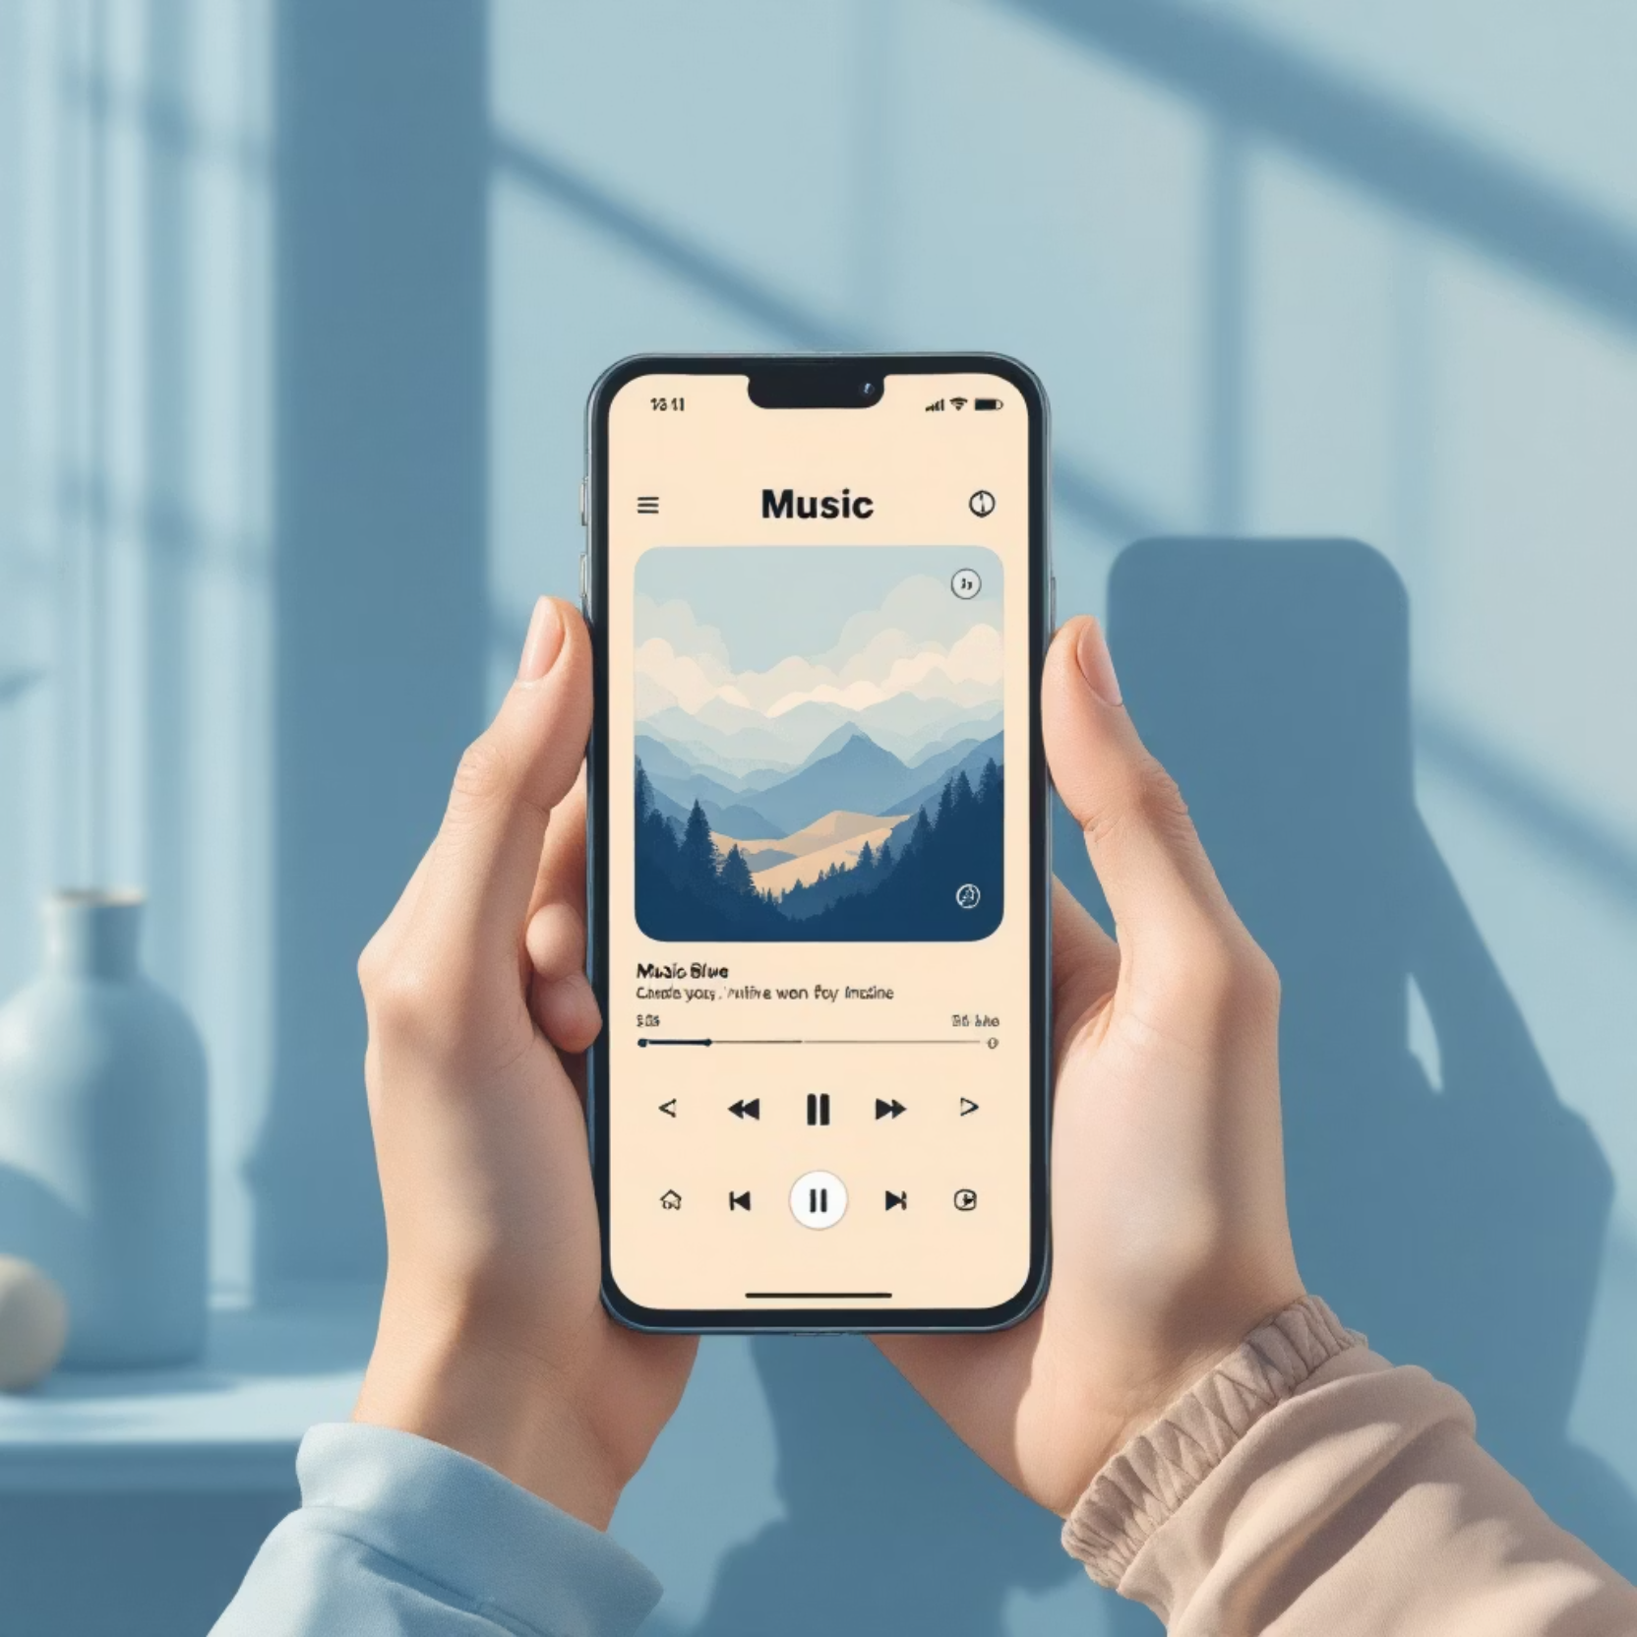

Revolutionizing Music Discovery
The Music Streaming App transforms how users discover and enjoy music through mood-driven design, personalized recommendations, and immersive visual experiences. Our mission is to create deeper connections between listeners and the music they love.
This project reimagines the music streaming experience by putting emotional resonance and personal taste at the center of every interaction.

Slide 3





The Problem We're Solving
Repetitive Recommendations
Emotional Disconnect
Discovery Challenges
Current platforms struggle to match music with users' moods, emotions, and specific activities
Finding fresh content aligned with personal taste requires too much effort and time
Users constantly hear the same songs and artists, leading to listening fatigue and disengagement
Users need a smarter, more intuitive way to discover music that resonates with their current state of mind and personal preferences.

Slide 4






Deep Dive: User Research Insights
Research Approach
Mood-Based Playlists Win
We conducted comprehensive surveys with 50+ music streaming users to understand listening behaviors, pain points, and preferences.
Users overwhelmingly prefer organizing music by mood and emotion over traditional genre categorization
Organization Pain Points
Playlist management feels cumbersome—users want smarter, more intuitive ways to organize their music
Visual Experience Matters
Interactive, visually engaging player interfaces significantly enhance the listening experience
Dark Mode Preference
Users strongly favor dark mode interfaces for music apps, citing reduced eye strain and immersive feel
Casual Listener
Music Explorer
Artist Follower
Enjoys background music during work or exercise. Seeks quick access to mood playlists.
Actively searches for new artists and genres. Values discovery features and recommendations.
Dedicated to favorite artists. Wants updates on new releases and curated artist content.

Slide 5

Information Architecture
We structured the app around five intuitive core navigation sections, each designed to support specific user needs and streamline the music discovery journey.
Home
Mood Explorer
Search
Personalized recommendations based on listening history and preferences
Browse and discover playlists organized by emotions and activities
Powerful search functionality to find songs, artists, albums, and playlists
My Library
Account
Access saved playlists, favorite tracks, and followed artists
Manage settings, preferences, and subscription details

Slide 6







Streamlined User Journey
Key Task: "Play a Mood-Based Playlist"
Open App
Launch with personalized home screen
Select Mood
Choose current emotional state
Choose Playlist
Browse curated mood options
Start Playback
Instant music streaming
Add to Favorites
Save for easy access later
Quick Access
Personalization
Simplified Navigation
Reduced clicks from launch to playback
Mood-driven recommendations
Intuitive, linear flow

Slide 7
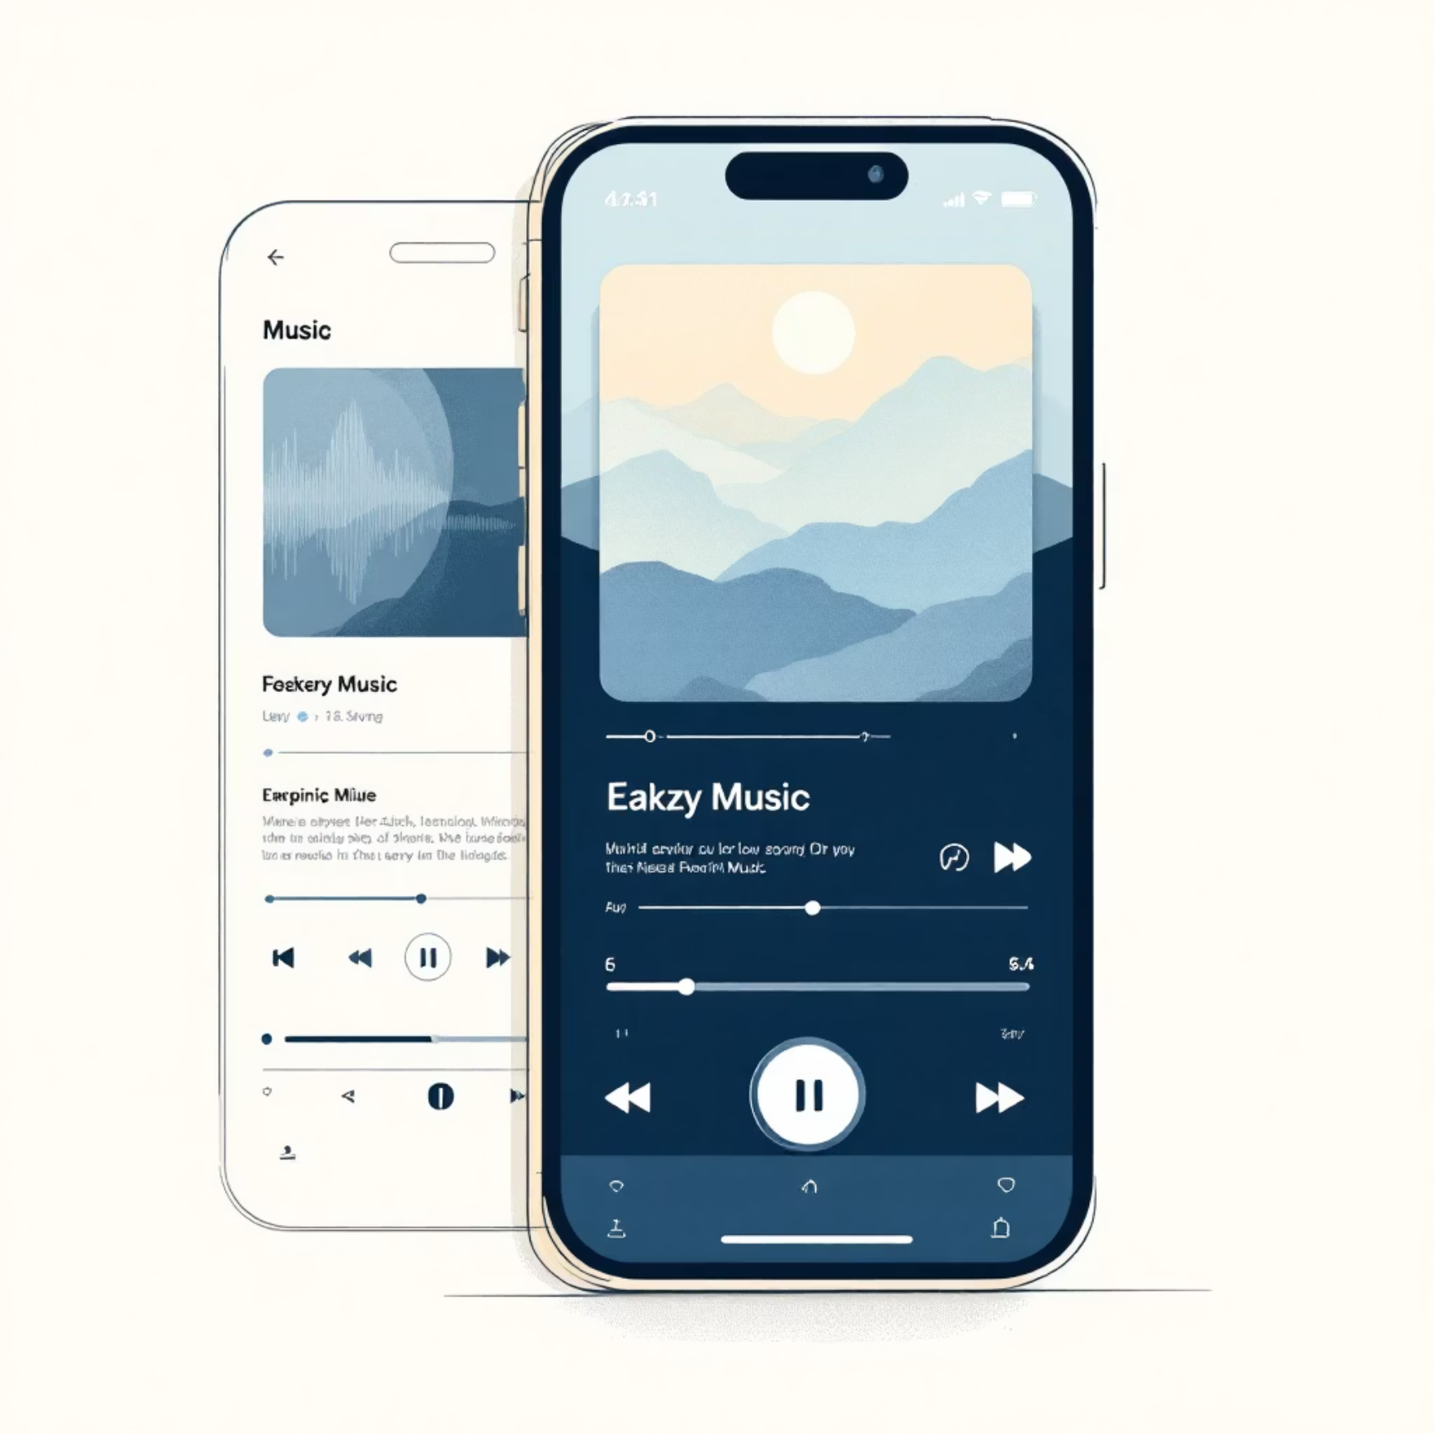



From Concept to Structure
Wireframes: Low & Mid Fidelity
We developed comprehensive wireframes to establish the foundational structure and user flow before diving into high-fidelity design. This iterative process allowed us to validate layouts and interactions early.
01
Player UI
Control layouts and visual hierarchy
02
Playlist Organization
Card structures and grouping systems
03
Recommendation Cards
Content presentation patterns
04
Mood Dashboard
Navigation and mood selection interfaces

Slide 8

A Dark Vibrant Visual Experience
Design Principles
Design System
Dynamic gradients with smooth animations
Typography: Gilroy for headings, Poppins for body text—modern, legible, and energetic
Rounded controls with tactile feedback
Color Palette: Bright, vibrant accents (#95CCDA, #C3643D, #64B8CE) contrast beautifully against deep dark backgrounds
Energy visualization during playback

Slide 9
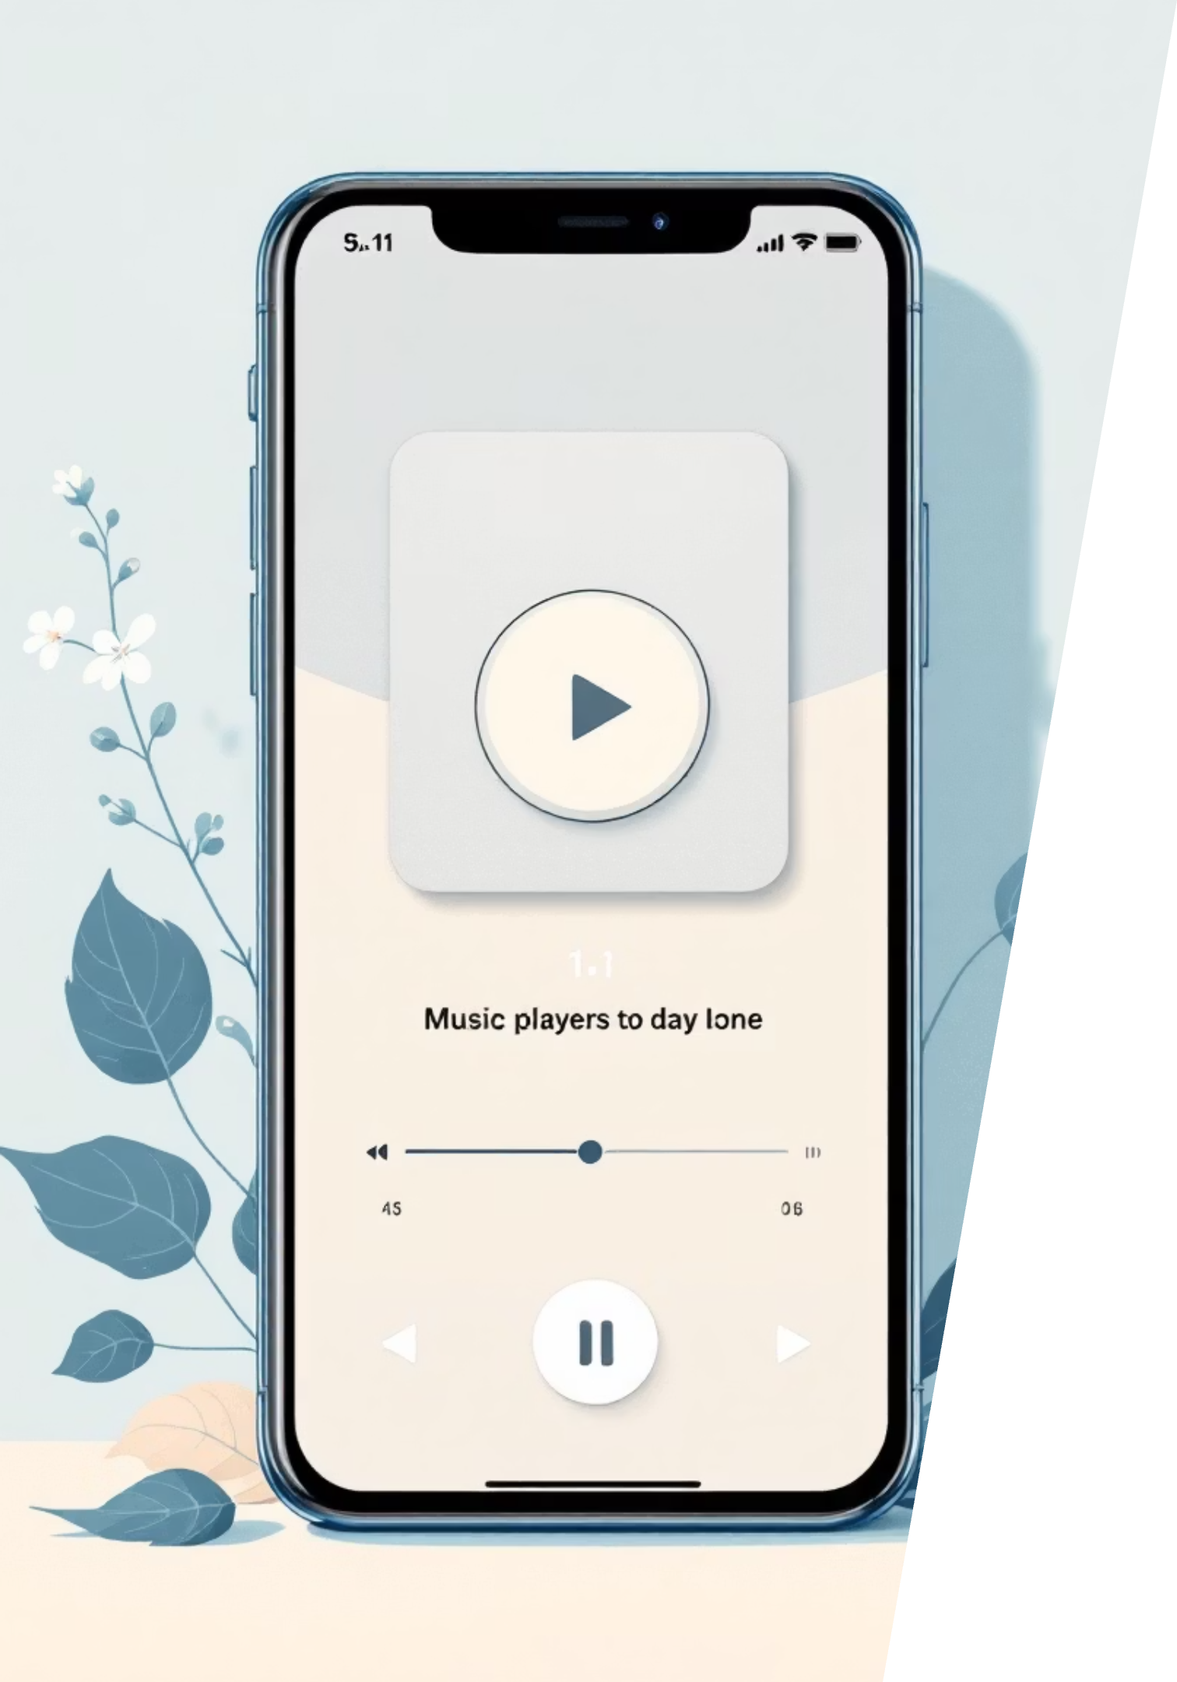






Bringing Designs to Life
Prototype & Interaction Design
Music Player Animations
Swipe Interactions
Fluid transitions between tracks with dynamic visualizations that respond to audio
Intuitive gesture controls for queue management and track navigation
Desktop Hover Effects
Rich micro-interactions that provide feedback and enhance the desktop experience
Usability Testing with Useberry
95%
We conducted comprehensive usability testing to validate our design decisions and ensure the experience met user expectations.
Task Completion
Users successfully completed key tasks

Slide 10
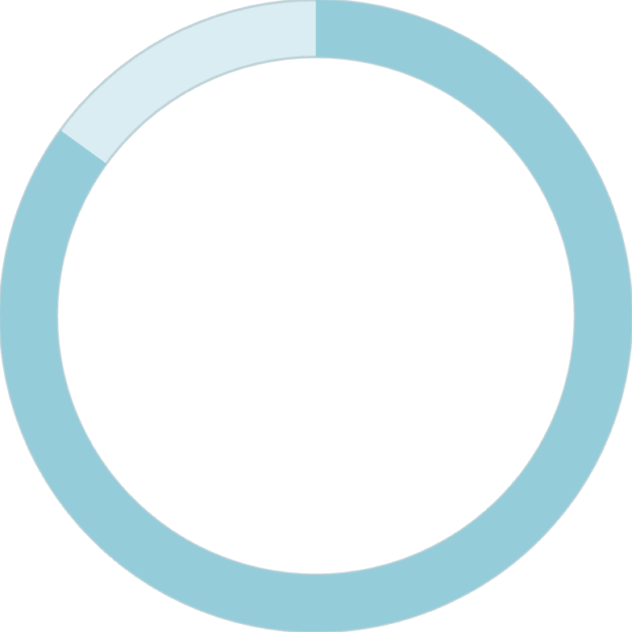
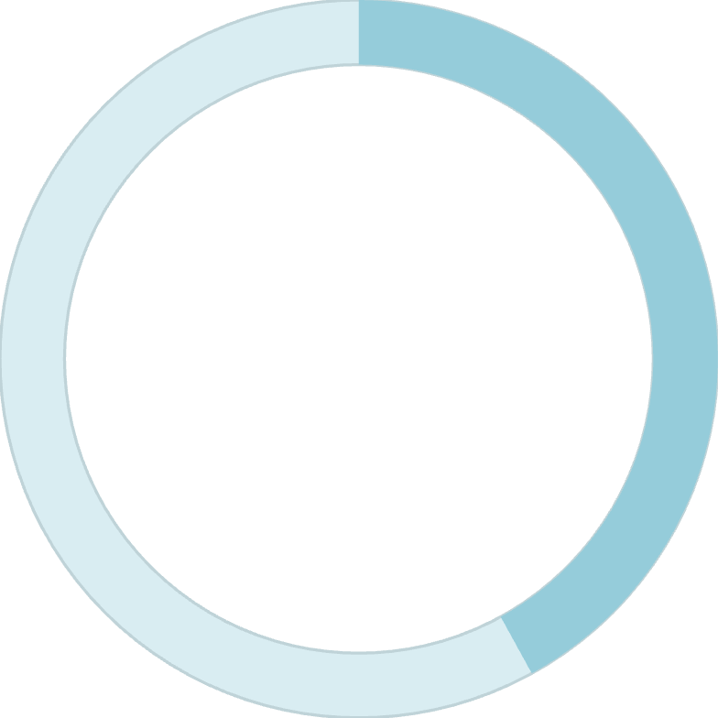
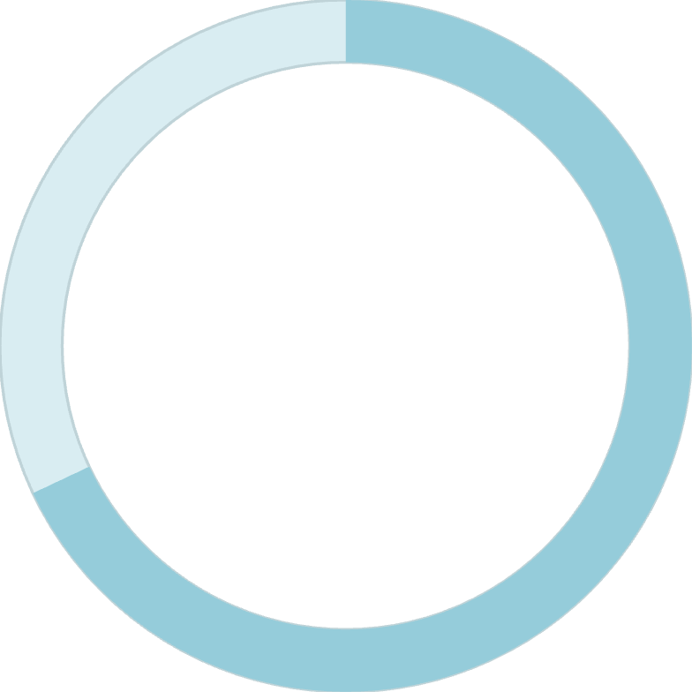

Results & Impact
85%
42%
68%
Increase in user satisfaction scores
Longer average session duration
Improvement in music discovery engagement
Enhanced Discovery
Visual Engagement
Personalization
Mood-based playlists revolutionized how users find new music
Immersive interface created deeper emotional connections
Smart recommendations aligned with individual taste
By centering the experience around mood-driven discovery, intuitive interactions, and visually stunning design, we created a music streaming app that doesn't just play songs—it connects users to the soundtrack of their lives.

